Slide 1
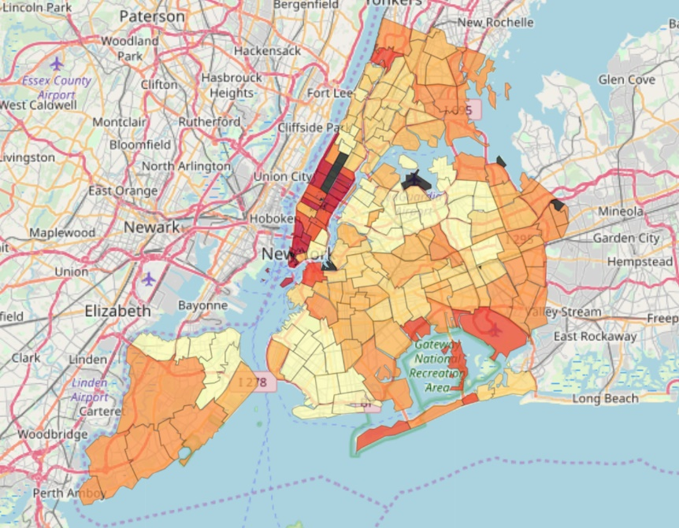
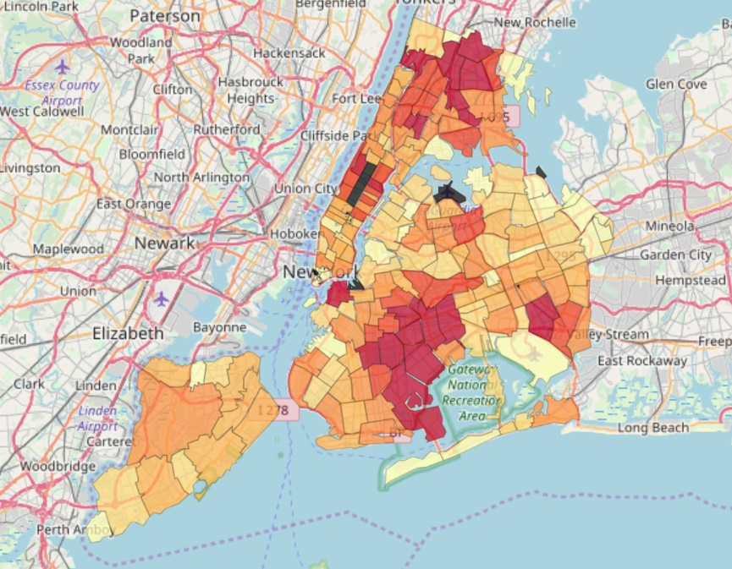
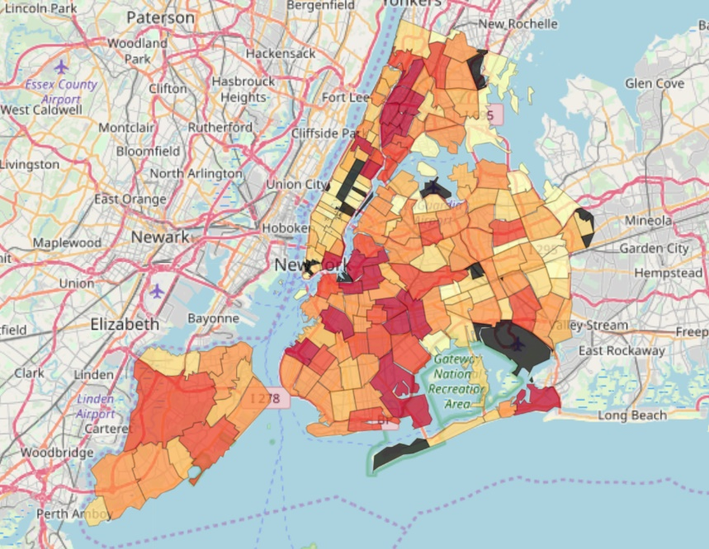
In NYC, parks tend to be located in residential areas that have a large number of medium to low income families
Weighted Average Income (HoH) per Family
Total HoH Income in a Zip Code
Number of Parks Distribution in NYC

